Slide 1
Introduction to Tableau
Lesson 18.1
Notes:
1.1

Slide 2
Class Objectives
By the end of this lesson, you will be able to:
Import and join data within Tableau
Create and style worksheets and stories in Tableau
Use Tableau worksheets to display data in a professional manner
Communicate data insights using Tableau stories

Slide 3
Welcome Students and Introduce This Week’s Topic
Notes:
1.1

Slide 4

Notes:
1.1 - temp

Slide 5
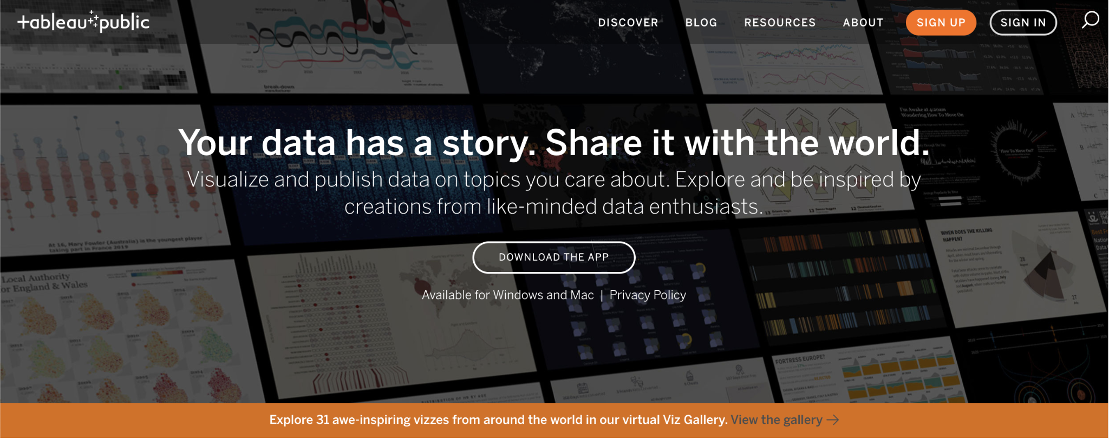
Welcome to Tableau!
Notes:
Point out the gallery of projects that Tableau users have created.
https://public.tableau.com/en-us/s/gallery

Slide 6
Instructor Do: Introduction to Tableau
Tableau is a powerful business intelligence application that allows users to quickly create in-depth visualizations.
Like Microsoft Excel, Tableau enables users to manipulate tables of data and create visualizations without additional programming.
Tableau also utilizes a drag-and-drop style interface so users can create tables and charts and perform analysis with ease.
Tableau enables users to share projects and visualizations with their community.
Visualizations can be shared on the Tableau site as well as embedded on webpages.
Tableau is essentially the "easy mode" of data visualization, and you will be able to use it to recreate many of your previous visualizations much faster than before.
Notes:
2.1

Slide 7
Everyone Do: Tableau Installation
In this activity, everyone will install Tableau Public.
Tableau Public is a free version of the Tableau software that includes most of the features available in Tableau Desktop.
10 Minutes
Notes:
1.2

Slide 8
Loading and Exploring Data
Notes:
2.1

Slide 9
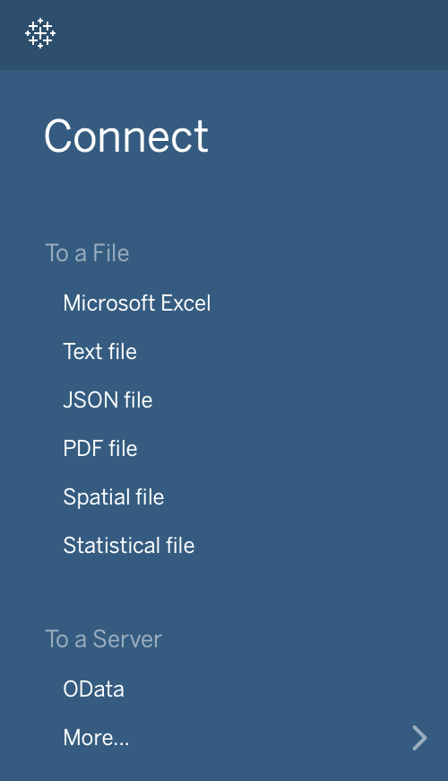
Instructor Do: Loading and Exploring Data
Not only can Tableau connect to many types of data files, like CSV, XLS, and JSON, it can also connect to a multitude of servers, such as MySQL, MongoDB, and Google Cloud.
Tableau allows users to mix and match data from vastly different sources without the need to translate the data into something like a Pandas DataFrame. The loading, exploration, and manipulation of data are all built-in.
Notes:
2.1

Slide 10
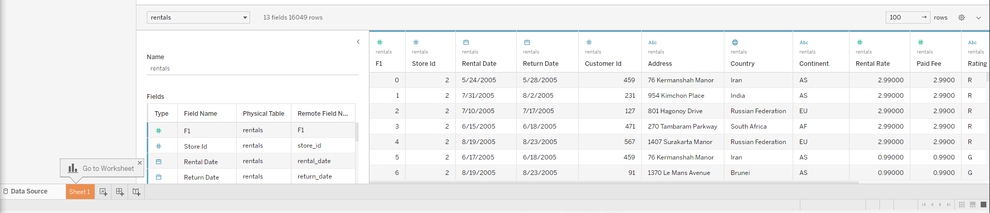
Instructor Do: Loading and Exploring Data
Select "Microsoft Excel" from the list of data sources available, and load GlobalRentals.xlsx within Tableau. After the data has been imported into Tableau, individual sheets from the original Excel workbook can be dragged from the navigator into the main application.
Notes:
2.1

Slide 11
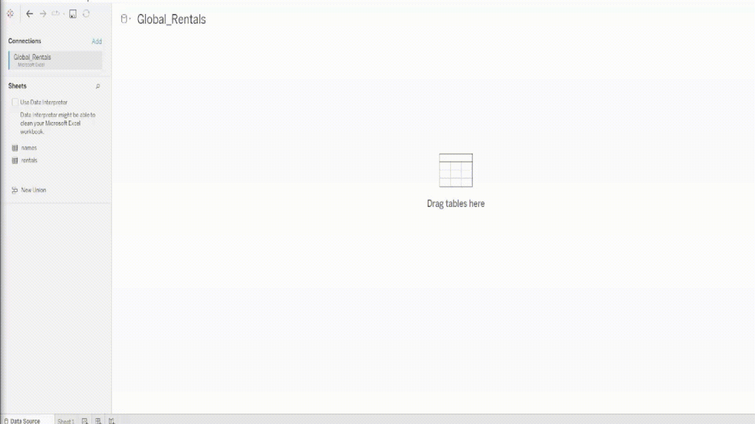
Instructor Do: Loading and Exploring Data
Once the data have been loaded, a preview is provided in the main area of the application
Notes:
2.1

Slide 12
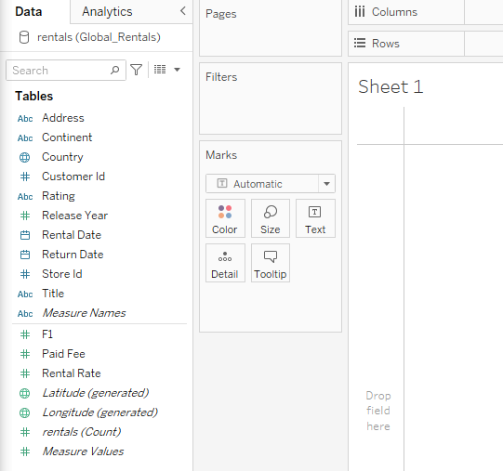
Instructor Do: Building Basic Visuals
Creating visualizations in Tableau is nearly identical to creating pivot tables in Excel. Users click and drag the headers of their original dataset into specific fields—Columns, Rows, Filters, etc.—to create a chart
Vocabulary: Dimensions are categorical fields that can be used to split up data. Measures are the metrics or numbers that users would like to analyze.
Notes:
2.1

Slide 13
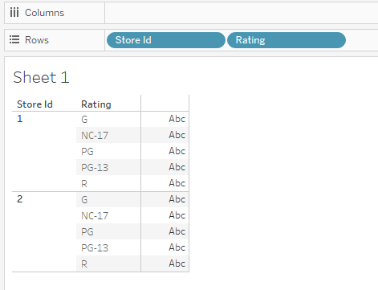
Instructor Do: Building Basic Visuals
Drag the Store Id pill from the Dimensions panel into Rows. This creates a small table with the two store ids from the dataset.
By dragging Rating into Rows and placing it after the Store Id pill, the table is made slightly more complex. Now, each store id within the visualization has been split into five distinct parts
Notes:
2.1

Slide 14
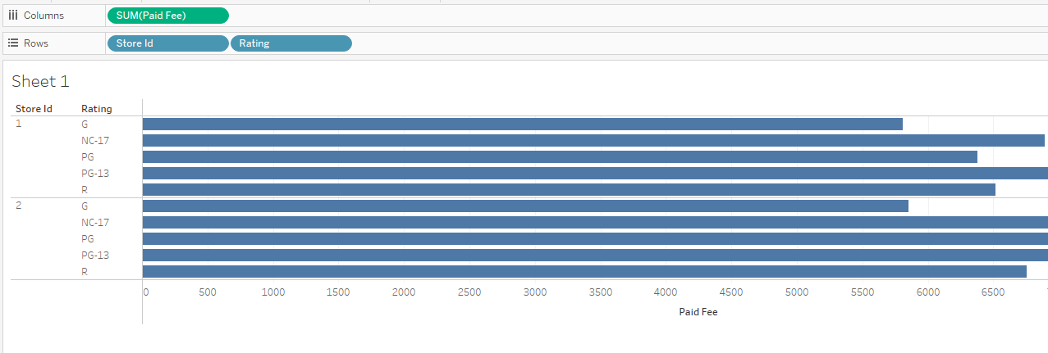
Instructor Do: Building Basic Visuals
Dragging "Paid Fee" from the Measurements panel and placing it within Columns, finally, creates a true visualization: a bar chart showing the total paid rental fees per rating for each store.
Notes:
2.1

Slide 15
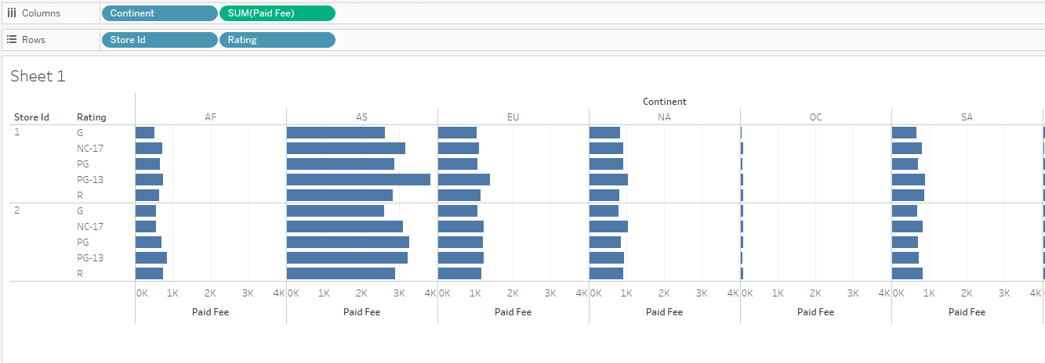
Instructor Do: Building Basic Visuals
The chart can then be made more detailed by adding more elements. By adding Continent into Columns, for example, multiple charts are created to show the paid rental fees per rating by continent for each store.
Notes:
2.1

Slide 16
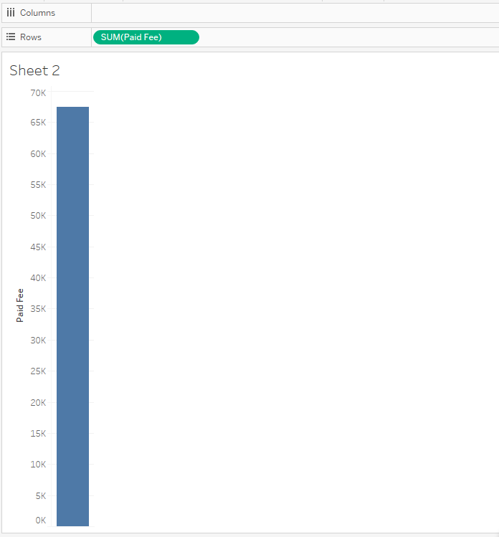
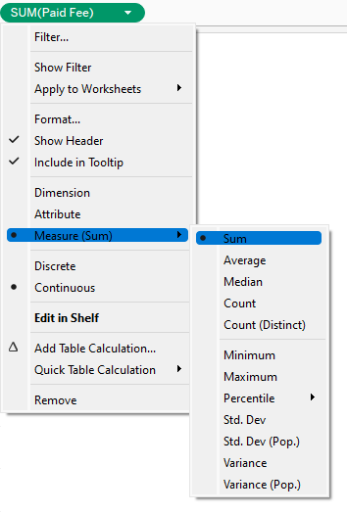
Instructor Do: Building Basic Visuals
Create a new worksheet within Tableau by clicking the "New Worksheet" button in the bottom left-hand menu. Drag Paid Fee into the Rows section.
The Paid Fee pill is being measured by its sum by default.
The type of calculation performed on a Measures pill can be changed by clicking on the pill, selecting Measure from the drop-down menu, and then picking one of the available calculation types.
Notes:
2.1

Slide 17
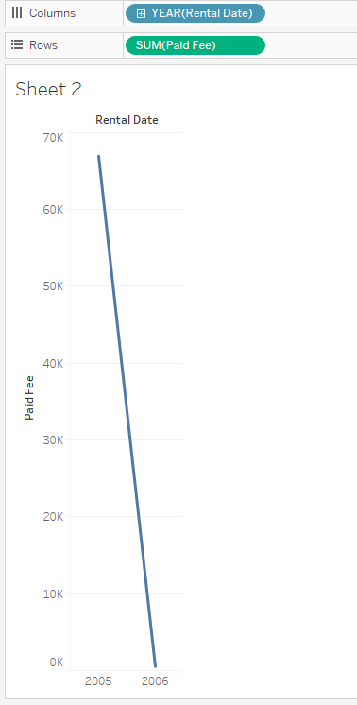
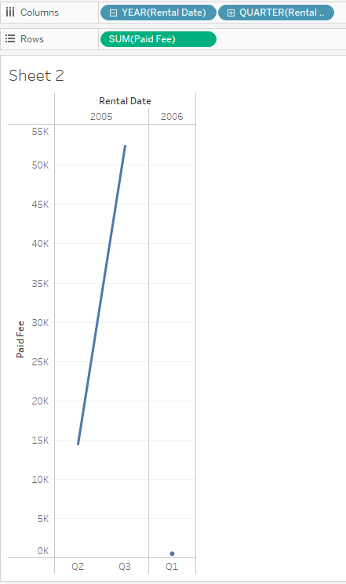
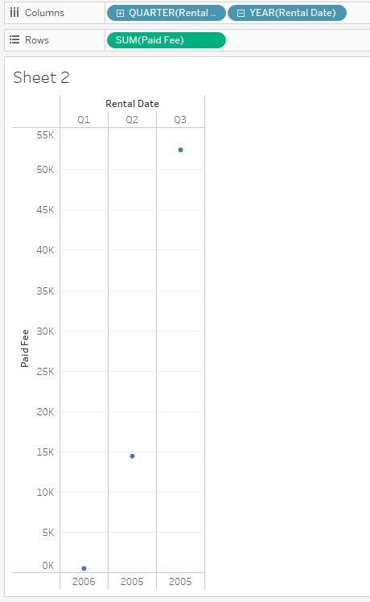
Instructor Do: Building Basic Visuals
Now, drag “Rental Date” into the Columns field to create a line chart. Tableau has aggregated the dates at the year level. To include quarters, simply click the plus symbol within the YEAR pill.
Notes:
2.1

Slide 18
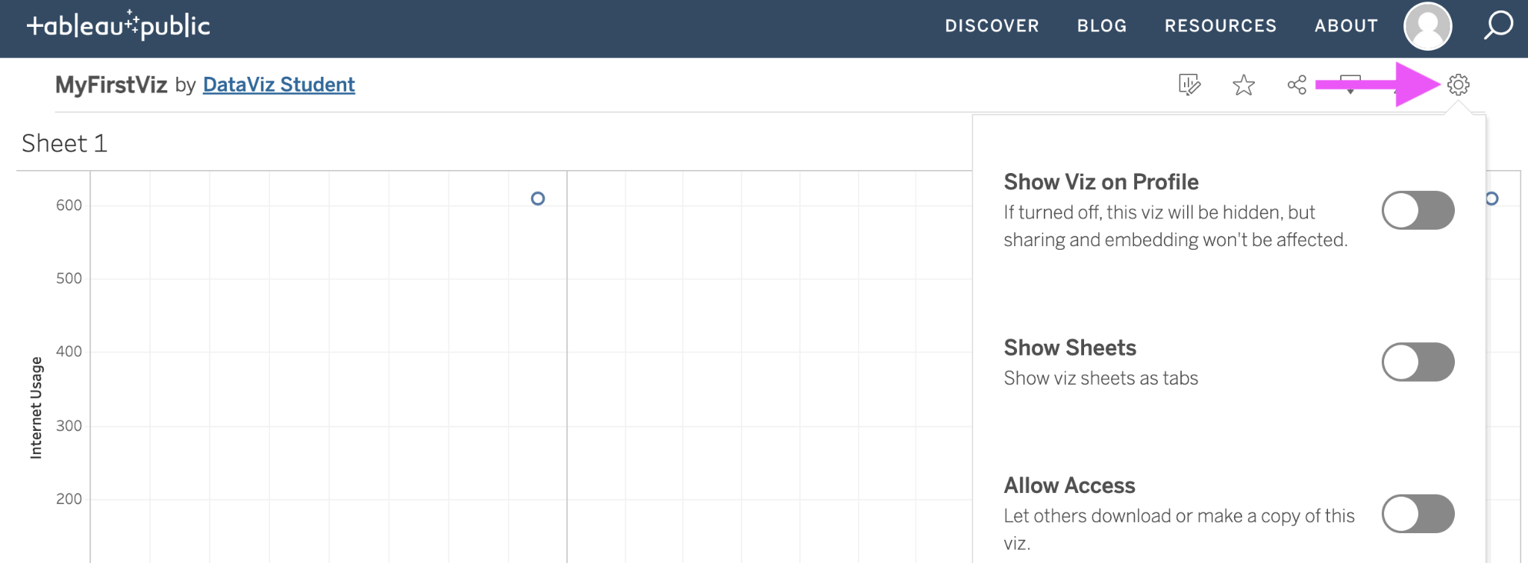
Instructor Do: Building Basic Visuals
Once your visualization is complete, save by clicking "File" then "Save to Tableau Public". After saving, the visualization will be uploaded to your profile, which will open in a new browser window. Adjust the settings of your new visualization by clicking the gear on the toolbar and toggling where to show the visualization.
Notes:
2.1

Slide 20
Activity: Explore Data
In this activity, you will be given visualizations that you will attempt to recreate using Tableau.
15 Minutes
Notes:
2.2

Slide 21

Activity: Explore Data
Instructions:
Using GlobalRentals.xlsx, visualize the following data:
The customers with the highest amount of paid fees
The customers with more than 150 rental days
The European countries with the highest average days of rental
A monthly timeline of payments for rentals
The rental days by continent and rating
Bonus:
If you finish early, try experimenting with other possible visualization!
Hint:
Don’t forget to save to Tableau Public once finished.
Notes:
2.2

Slide 22
Notes:
2.3

Slide 23
Activity: Appointment No-Shows
In this activity, you will create visualizations which provide insights about who is more or less likely to show up to a doctor’s appointment
20 Minutes
Notes:
2.2

Slide 24
Activity: Appointment No-Shows
Instructions:
Create a line chart that compares the ages of patients against the total number of appointments. Then, split this graph based on scholarship and whether the patient showed up to their appointment.
For this first step, you'll need to convert Age from a Measure to a Dimension.
Create a pair of bar charts that compare how many patients showed up to appointments versus how many were no-shows in different neighborhoods.
Create a stacked bar chart that compares no-shows to those who made it to their appointment based on the day of the week.
Create a pair of line graphs to compare age and diabetes in patients who showed up to appointments versus those who were no-shows.
Create a pair of line graphs to compare age and alcoholism in patients who showed up to appointments versus those who were no-shows.
Notes:
2.2

Slide 25
Notes:
2.3

Slide 26
Joins and Splitting Made Easy
Notes:
3.1

Slide 27
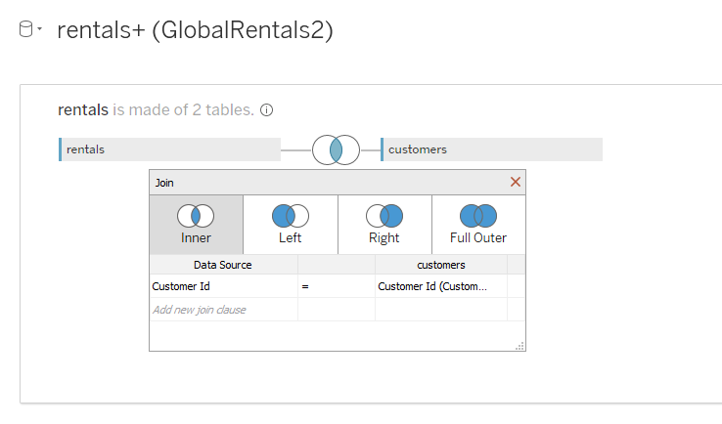
Instructor Do: Joins and Splitting Made Easy
Joins are a constant in data science, and they are often considered tedious and complex. Tableau, however, simplifies joins so much that even complex joins can be performed in just a few clicks.
Notes:
To change what type of join is used, simply click on the interlacing circles at the top of the application, and select what form of join to use from the menu, as in the following image; this same menu can be used to modify what columns to merge on.

Slide 28
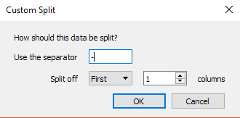
Instructor Do: Joins and Splitting Made Easy
Another interesting feature of Tableau is that columns containing text can be split to extract data
To do so, navigate to the first sheet and scroll through the data to select the column header whose values should be split, then right-click, and select "Transform" then "Custom Split" from the drop-down menu.
Select what character to split the text on, whether to split from the beginning or the end of the string, and then how many times the text should be split.
Split the "Rent Code" column on the first hyphen one time; this will extract the store id in which a movie was rented from the initial string.
Notes:
2.1

Slide 29
Activity: Major League Baseball Analysis
In this activity, you will create tables based on MLB All-Star Teams datasets.
20 Minutes
Notes:
3.2

Slide 30
Activity: Major League Baseball Analysis
Instructions:
Create a join between each of the charts so that each player's data is matched up correctly.
Create a pair of charts that compare the offensive talent of a player (OFF600 column) to their fielding talent(DEF600 column). Then sort them from best to worst.
Create a chart that determines which game (GameID column) has the highest offensive talent (OFF600 column).
Create a chart that determines which position (startingPos column) has the greatest fielding talent (DEF600 column) on average. In a second chart, Be sure to note how many players are from each position in a second chart.
Create a chart that determines which year has the greatest pitching power (PITCH200 column) on average.
Create a chart that marks year versus the average offensive talent (OFF600 column).
Notes:
3.2

Slide 31
Notes:
3.3

Slide 32

Notes:
-------------------
Image source: AdobeStock_56885471

Slide 33
Sizing, Coloring, and Labels
Notes:
4.1

Slide 34
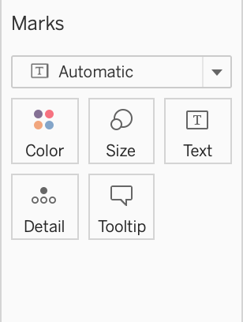
Instructor Do: Sizing, Coloring, and Labels
Marks, on the left side of the workbook, can be used to differentiate or add details to a chart's visuals.
Color lets users modify the color of chart elements.
Size lets users modify the size of chart elements.
Label lets users position text next to points on the chart.
Detail and Tooltip act like labels but only appear when the cursor hovers over the associated point or element on a chart.
Pills can be dragged to these marks to create visual effects.
Notes:
2.1

Slide 35
Activity: The Ultimate Candy
In this activity, you will create charts to compare candy qualities and popularity.
10 Minutes
Notes:
3.2

Slide 36
Activity: Major League Baseball Analysis
Instructions:
Create a pair of bar graphs that chart the win percentage of each candy, then color the bars according to whether they are fruity and/or chocolatey.
Create a scatter plot comparing the sugar percentage against the win percentage. Color the points based on whether they are chocolatey, and size them according to price.
Create one more scatter plot comparing the sugar percentage against the win percentage. Color the points based on whether they are fruity, and size them according to price.
Hint:
Don’t forget to save to Tableau Public once finished.
Notes:
3.2

Slide 37
Notes:
3.3

Slide 38
Storytelling
Notes:
4.1

Slide 39
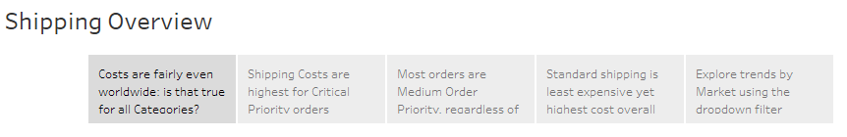
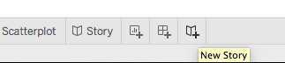
Instructor Do: Storytelling
Sometimes, a single chart does not provide viewers with all of the information they might want. Stories are a Tableau feature that make it easier to bring together multiple charts in one place.
A new story can be created by selecting the New Story button from the tabs at the bottom of the workbook

Slide 40
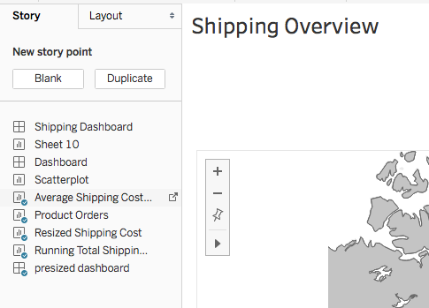
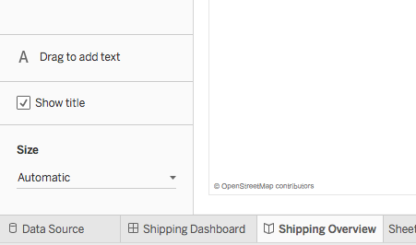
Instructor Do: Storytelling
To add a new page to a story, navigate to the New Story Point, and select either Blank to create a blank page or Duplicate to create a page based on an already existing page
Text boxes allowing for more detailed explanations can also be added by dragging the Drag to Add Text element onto the page
Notes:
2.1

Slide 41
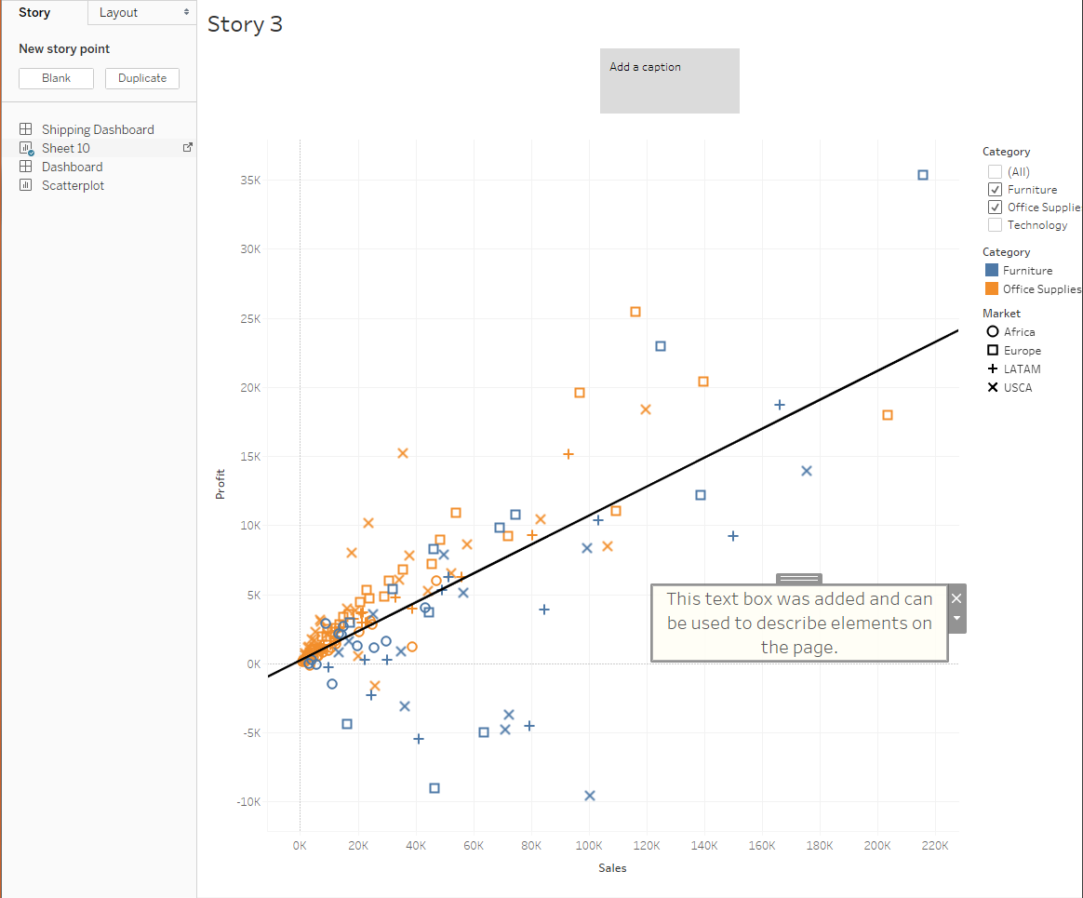
Instructor Do: Storytelling
The left side of the page will contain all of the sheets within the current workbook, and they can be added into the story by dragging them into the main area.
Captions for the story point can be added or edited by clicking the gray box at the top of the main view.

Slide 43
Activity: Degrees That Pay
In this activity, you will use what you’ve learned today to create a Tableau story about degrees that pay.
15 Minutes
Notes:
3.2

Slide 44
Activity: Degrees That Pay
Instructions:
Create a story using the datasets provided, and formulate graphs that might be used to explore the following questions:
"Do engineering majors earn higher salaries than other majors?"
"Is attending grad school associated with higher pay?"
"Do higher salaries lead to higher or lower unemployment rates?"
Bonus:
Create a chart that visualizes median and 75th percentile salaries, by major, split between graduate and non-graduate degrees.
Hint:
You do not have to join any of the data for this activity. The worksheets that you will be creating do not require you to join the datasets in Tableau.
Notes:
3.2

Slide 45
Notes:
3.3

